Slide 1
Modelling in Conservation Biology
Marc H. Taylor
marc.taylor@thuenen.de

Slide 2
Course Outline
Day | Time | Topics | Form
Friday, May 24, 2019 | 10:00 - 12:00 | • General introductions & course outline • The importance of marine conservation • Conservation-related differences between non-marine and marine realms • Principles that transcend land-freshwater-marine differences • Marine Populations: the basics • Applications of modelling in conservation biology •The realm of Population Viability Analysis (PVA) | Lecture
 | 13:00 - 17:00 | • An Introduction to [R] | R
Monday, June 27, 2019 | 9:00 - 12:00 | • Types and potential uses of Population Viability Analysis (PVA) • A First model; PVA cont. | Lecture & R
 | 13:00 - 16:00 | • Case Study I. White rhinoceros on Ndumu Reserve | Lecture & R
Tuesday, June 28, 2019 | 9:00 - 12:00 | • Case Study I cont.; Risk assessment explorations | R
 | 13:00 - 16:00 | • Case Study II. Loggerhead turtle matrix model • Age-structured vs stage-structured population models • Introduction to matrix calculations; Calculation of eigenvalues and eigenvectors | Lecture & R
Wednesday, June 29, 2019 | 9:00 - 12:00 | • Considering metapopulations in conservation biology • Metapopulation model example | Lecture & R
 | 13:00 - 16:00 | • Management Strategy Evaluation (MSE) in fisheries • The use of Agent-Based Models (ABMs or IBMs) - Netlogo platform intro • Review & Questions

Slide 3
What is the value in conservation?
“The worst thing that can happen—will happen—is not energy depletion, economic collapse, limited nuclear war, or conquest by a totalitarian government. As terrible as these catastrophes will be for us, they can be repaired within a few generations. The one process ongoing…that will take millions of years to correct, is the loss of genetic and species diversity by the destruction of natural habitats. This is the folly our descendants are least likely to forgive us” – E.O. Wilson

Slide 4
Introduction into the course concept
Conservation biologists have in mind to keep as many species as possible from becoming extinct as long as possible. Common questions for them are:
"How will the abundance of a population change in the future?"
"How long will the population persist?"
However, the main question can be formulated as follows:
“What is the risk the population will become extinct?”

Slide 5
Introduction into the course concept
…thus the concept of “risk assessment" in the conservation of species.
Risk assessment requires the definition of processes which influence the births and deaths (demography)
This is especially important if the number of individuals in the population is small.
Even if information is rare, resource managers may still be called upon to make decisions:
How should a stocking program be managed?
Where should re-introductions be planned to optimize results?
Is it better to spend resources to combat poaching or to enhance or extend habitat?

Slide 6
Introduction into the course concept
Models can help in that purpose although they are simplified representations of reality. We can use them successfully as long as we consider that they are only abstractions of how we think nature operates.
This course will give an introduction how questions in conservation biology can be formulated and answered by means of models which are developed for Population Viability Analyses (PVA).
For further reading:
M.A.Burgman, S.Ferson & H.R.Akçakaya, 1993. "Risk assessment in conservation biology”
William F. Morris & Daniel F. Doak, 2002. "Quantitative Conservation Biology"

Slide 7
Conservation-Related Differences Between Non-Marine and Marine realms
Characteristic | Conservation Implication | Examples
1) The sea is much larger | •Key processes of marine species and ecosystems routinely violate the boundaries among and within nations that are the spatial basis of governance | •Life-history (spawning, recruitment, migration) •Increased connectivity
2) Seawater is less transparent than air | •It is much more difficult to do remote observations of species and ecosystems in the depth of the sea than on land | •Population / biomass estimates
3) The sea is more 3-dimensional | •Decreased accessibility •Increased buoyancy leads to different functional groups – requiring new methodologies for study •Ex-situ studies difficult and costly | •New sampling methods •Increased importance of suspension feeders, plankton and nekton •Maintenance of aquaria
from Norse and Crowder, 2005

Slide 8
Marine vs. Non-marine Cont.
Characteristic | Conservation Implication | Examples
4) Marine spp have longer potential dispersal distances | •Reproductive modes involving passive transport may result in large life-cycle closures – thus, the protection of single geographic locations may not be effective | • Planktonic larvae • Corridors for return migrations • The concept of a "metapopulation" may need to be considered
5) Pelagic ecosystems undergo rapid spatial shifts | •Contrary to the stability of benthic environments, pelagic environments are in constant flux. Variability in identifiable physical ecosystem features (e.g. currents, water masses, convergence zones, eddys, upwellings) and their associated biota create difficulties in defining conservations areas. | • Classification of pelagic ecosystems must incorporate these shifting ecosystem boundaries – Spatial ecology in marine systems must become dynamic and 3-D
6) Patchiness of producer and consumer biomass in time | •Crossing of international boundaries by higher predators. Some evidence of increased vulnerability to starvation due to climate changes. | • Large ranges of higher consumers (e.g. birds, fishes, marine mammals, sea turtles) needed to locate food patches

Slide 9
Marine vs. Non-marine Cont.
Characteristic | Conservation Implication | Examples
7) Steep gradients | •Deeper waters are quite stable environments – this scarcity of disturbance has exerted far less selection pressure on deep-sea species to resist and recover from disturbance. | •Nearshore species and ecosystems are the most heavily impacted, but also recover the fastest. Deep sea trawling has very long-lived negative effects.
8) Geochemically downhill from land | •Few pathway by which materials are returned from the sea to the land. What happens on land has far more influence on the sea than vice-versa. | •Run-off from agriculture, mining, logging. Sea to land vectors are spawning migrations of anadromous fish, guano-producing seabirds.

Slide 10
Marine vs. Non-marine Cont.
Characteristic | Conservation Implication | Examples
9) Fisheries are more like hunter/gatherers than farming | •With the exception of aquaculture, humans do not control breeding, feeding, waste disposal or disease in marine species. The lack of property rights may lead to "the tragedy of the commons" | •Pelagic species, highly migratory species (e.g. whales, tuna)
10) Far less cultural and legal protection | •Historically, lower investment in conservation. Spending reflects society's perceptions, and perceptions are limited by space and time. | •A ratio of 1:13 between marine and terrestrial papers existed in the first 9 years of publication for the journal Conservation Biology (Irish and Norse, 1996) •Shifting baselines (Pauly)

Slide 11
Marine Populations: the basics
Reproductive features
Fecundity patterns
Settlement, Recruitment and Dispersal Patterns

Slide 12
Reproductive features: Spawning method
Broadcast
Release of both eggs and sperm into the water - most fishes, echinoderms and many algae
Internal fertilization
Female collection of sperm from water and used for internal fertilization - prominent in sponges, cnidarians, mollusks, red algae and ascidians
Following copulation, where males place sperm inside the female's reproductive tract – many gastropods, most crustacean, sharks, some boney fishes, and all mammals.

Slide 13
Reproductive features: Spawning method
Fertilization method and fertilization success are probably highly correlated:
Broadcast spawning
Dilution effect - hydrodynamic theory (Danny and Shibata, 1989) and empirical observations (Levitan et al., 1992, Levitan, 1993) suggest that broadcast spawning can result in poor fertilization success if males and females are more than a few meters apart from one another (Pennington, 1985) or if spawning occurs in rough water with high turbulent flow.
Thus, small populations of scattered adults might produce few successfully fertilized eggs (i.e. Allee effect) unless behavioral mechanisms like simultaneous spawning are used to enhance contact between eggs and sperm
Low adult density and fertilization success has been blamed on the poor recovery of some depleted populations (e.g. Caribbean urchin Diadema, California abalone Haliotis spp.)

Slide 14
Reproductive features: Spawning method
Fertilization method and fertilization success are probably highly correlated:
Internal fertilization following female collection of broadcast sperm
Captured during feeding and somehow (not known) distinguish the sperm, which gets separated and passed to the eggs in the ovaries or brood chambers.
Distance between adults appears to affect the success of sperm capture in some cases, although densities can be lower with this strategy than with simultaneous broadcast spawning
Internal fertilization following copulation
Little study on the success in copulation with internal fertilization, yet it is assumed that the behavioral complexity of species with copulation ensures that most individuals have no difficulty finding mates. Some cases do exist that are likely a result of difficulty finding a mate (e.g. fin- and blue whale hybrids, gender-biased fishing of grouper, hake, and crabs is thought to skew sex ratios perhaps leading to reductions in fertilization rate)
Thus, mating and internal fertilization are probably the least dependant on environment and can reduce variation in reproductive success among females.

Slide 15
Reproductive features: Developmental mode
Planktonic larvae that drift in ocean currents (common in fish, echinoderms, mollusks, polychaetes and crustaceans)
Planktonic period may vary enormously (e.g. 15 min. in many algae, ascidians and sponges to months in lobsters, 4-8 weeks is more typical in marine invertebrates and fish larvae tend to be between 10-20 days)
Active feeding is usually required in longer larvae periods (beyond a few days)

Slide 16
Fecundity Patterns
Generally, marine species have much higher fecundity and potential number of offspring than terrestrial species
Marine species with lower fecundity typically produce larger offspring
May be accompanied by live birth, brooding, direct development to free moving juveniles
High mortality rates (e.g. 2% → 20% in plankton larvae; ex. 95% in Engraulis ringens)

Slide 17
Fecundity Patterns: Variations in reproductive success
High fecundity combined with early mortality can cause large variance in reproductive success.
Ex. Oysters produce millions of eggs, whose recruitment success will depend highly on the timing with environmental conditions. Some individuals will be big “winners” in the recruitment lottery, while many will be “losers”
The consequence of this may be that the “effective population” size may be several orders of magnitude lower than the actual population size. Human impact may be unexpectedly large even with large actual population numbers.

Slide 18
Settlement, Recruitment and Dispersal Patterns
Larval limitation can be more limiting than adult interaction – “supply-side ecology” (Lewis, 1986)
High recruitment variability due to variable environment (ex. Barnacles show high recruitment during low upwelling along the California coast – retention; match-mismatch, Cushing 1966)
Recruitment can occur in “hot spots”
Oceanic conditions and circulation patterns affect recruitment spatially (ex. Large-scale gyres, estuarine circulation, convergence zones, strong upwelling zones)
Dispersal range is not always determined by larval development time
Behavioural adaptations can affect dispersal (e.g. vertical migr.)
Oceanography can create biogeographic boundaries - preventing exchange of genetic material
Self-recruitment has been documented for many species with long-lived larval stages due to retention processes

Slide 19
Applications of modelling in marine populations
How can we affect population dynamics through management?
Modelling examples:
Fisheries Biology
r- vs. K-strategists and implications for conservation
Metapopulation Analysis

Slide 20
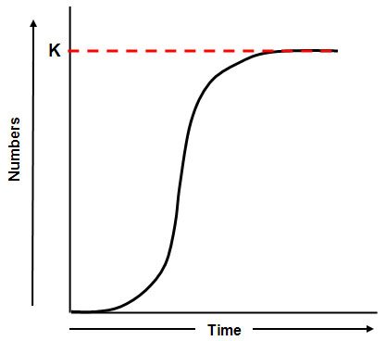
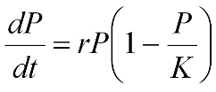
Logistic growth function
Pierre-François Verhulst (1804-1849)
A common model of population growth, where the rate of reproduction is proportional to:
the existing population
the amount of available resources (defines carrying cappacity)
P represents population size
t represents time
r defines the growth rate
K is the carrying capacity

Slide 21
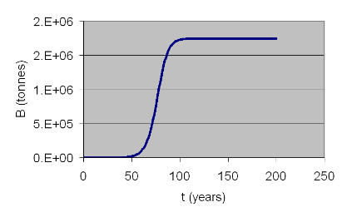
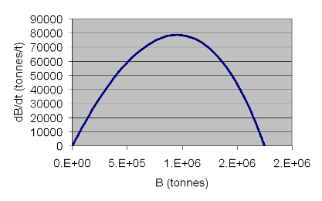
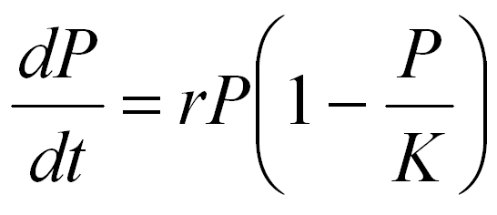
Fisheries Biology
Historically focused on managing the population size (through fishing mortality) in order to maximize (dB/dt)
MSY
ex. Schaefer model

Slide 22

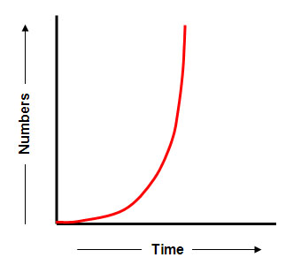
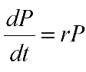
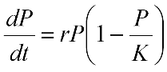
Allee effect – reduction of mating success with declining density
Deviates from the sigmoidal population curve at low densities due to reproductive failure (i.e. decrease in r)
May be especially important in broadcast spawners – typically r-strategists

Slide 23
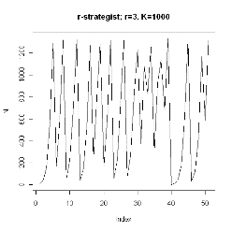
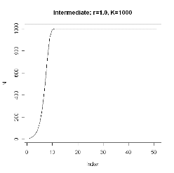
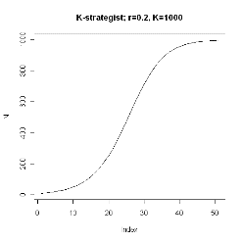
r- vs. K-strategists: implications for conservation
The Allee effect (reduction of mating success with declining density) is likely to be a greater problem in broadcast spawning strategies (more typical in r-strategists.
but,…K-strategists have their own problems…

Slide 24
r- vs. K-strategists: implications for conservation
K-strategists have slow recovery rates, but are more stable at large population sizes
When population sizes are strongly reduced, the natural variation in reproduction can have grave consequences

Slide 25
The realm of Population Viability Analysis (PVA)
not of interest

Slide 26
The realm of PVA
highly interesting but mostly overlooked

Slide 27
The realm of PVA
Population Viability Analysis

Slide 28
Template
template
To the computers…
…Practical handbook
1. R Basics

Slide 29
How to produce uniform random numbers?
Many computer programs provide such numbers by so called „pseudo-random generators“
e.g. rnorm( ), runif( )
Such a generator provides a deterministic sequence of pseudo-random numbers, based on some algorithm and internal computer state.
These generators are sensitive to their (initial) parameters.
The sequence of pseudo-random numbers produced is limited. If the limit is achieved, the same sequence of numbers will be repeated.
e.g. default: "Mersenne-Twister" (Matsumoto and Nishimura, 1998) with period of 2^19937 – 1

Slide 30
A sequence of uniform pseudo-random numbers
(Mersenne Twister - MT19937 )
0.1367 0.8013 0.6575 0.6523 0.4967 0.0191 0.4591
0.0056 0.1668 0.5371 0.9987 0.7694 0.3904 0.2054
0.1212 0.2341 0.5370 0.9940 0.6840 0.3670 0.0326
0.9188 0.6192 0.2748 0.0204 0.2994 0.8105 0.9798
0.4804 0.0667 0.1780 0.0715 0.4733 0.4552 0.3510
0.9005 0.3544 0.0880 0.6054 0.8668 0.0204 0.9723
0.4438 0.4440 0.7719 0.4050 0.1576 0.8309 0.7203
0.3786 0.9682 0.9996 0.4080 0.2928 0.4987 0.3511
0.9639 0.9807 0.1892 0.1822 0.6380 0.6150 0.7066
0.6077 0.1348 0.4028 0.2148 0.5480 0.0869 0.9737
0.7316 0.4722 0.7254 0.5569 0.4255 0.6103 0.3082
0.3220 0.8773 0.3331 0.2954 0.2194 0.5701 0.1752
0.8004 0.2978 0.4105 0.3024 0.9858 0.6708 0.7309
0.0240 0.1992 0.5695 0.7658 0.4715 0.8854 0.8083
0.0304 0.8951 0.5296 0.5840 0.4050 0.6437 0.6014
0.7471 0.5054 0.3790 0.5667 0.4343 0.2375 0.5668
0.7591 0.9195 0.6950 0.8018 0.0417 0.9680 0.8975
0.4739 0.7872 0.4957 0.5854 0.4827 0.1496 0.5511
0.6452 0.9351 0.4404 0.4727 0.1858 0.5499 0.5476
0.0058 0.2967 0.0882 0.0543 0.0681 0.9624 0.9895
0.0335 0.4665 0.6618 0.0409 0.3664 0.9793 0.1087
0.6459 0.9361 0.6951 0.7908 0.2717 0.4827 0.2269
0.7312 0.5853 0.4897 0.5698 0.0117 0.7696 0.7501
0.3051 0.9911 0.2494 0.7218 0.9587 0.4468 0.5189
0.6976 0.3707 0.2024 0.9233 0.8389 0.3971 0.2255
0.7658 0.3621 0.1385 0.7367 0.2801 0.3389 0.7556
0.0083 0.0760 0.1159 0.1465 0.6918 0.4534 0.1453
0.3857 0.0384 0.6548 0.2075 0.6887 0.1393 0.1993
0.8265 0.9301 0.1389 0.7254 0.2699 0.1848 0.3461
0.1779 0.3804 0.3498 0.4408 0.7739 0.7282 0.8478
0.6160 0.7853 0.7462 0.4684 0.6997 0.3835 0.5383
0.5676 0.1531 0.5385 0.6673 0.7641 0.3434 0.3669
0.3217 0.6763 0.3708 0.2032 0.9615 0.3519 0.2251
0.2693 0.7798 0.0767 0.2787 0.1805 0.8499 0.3582
0.4226 0.9468 0.2904 0.1357 0.7864 0.9133 0.3341
0.5918 0.1413 0.9163 0.3336 0.5769 0.6876 0.0358
0.0281 0.2045 0.6094 0.5053 0.0359 0.2558 0.3720
0.6275 0.0497 0.9622 0.2452 0.0625 0.7784 0.3619

Slide 31
Template
template
End…
…Practical handbook
1. R Basics

Slide 32
Types of Population Viability Analysis
“PVA” is an acronym for a range of data analyses and modelling methods. It is not a single analytical tool. We distinguish between different PVA types depending on the specific conservation task

Slide 33
Types of PVA (cont.)
count-based PVA: predict the total number of a single population. The estimated model parameters are frequently based on census data.
demographic PVA: whereas count-based PVAs consider individuals in a population as identical, demographic PVA models describe life stages and the resulting population structure explicitly. This focus helps to identify key processes and stages to be protected or to be supported by management. However, demographic PVAs provide better predictions when enough data exist. With less information, a simple count-based PVA can provide more reliable results, even with highly structured populations (Ludwig & Walters, 1985).
multi-site PVA: For species that exist as metapopulations, the analysis of the fate of single populations will not be adequate to assess the vulnerability to regional or global extinction. Models focus on a set of multiple populations connected by individuals' dispersal form a broad category of models. They contain present-absence models, sophisticated functional models, models which describe the spatial arrangement and the dispersal of the individuals explicitly, individual-based models, as well as GIS-based models. To get a good overview the book Metapopulations by Hanski (2000) is highly recommended.

Slide 34
Potential uses PVA
Category of Use | Specific Use | Examples
Assessment of extinction risk | Assessing the risk of a single population | Shaffer 1981, Shaffer and Samson 1985, Lande 1988a
 | Comparing relative risks of two or more populations | Menges 1990, Forsman et al. 1996, Allendorf et al. 1997
 | Analyzing and synthesizing monitoring data | Menges and Gordon 1996, Gerber et al. 1999
Guiding management | Identifying key life stages or demographic processes as management targets | Crouse et al. 1987
 | Determining how large a reserve needs to be to gain a desired level of protection from extinction | Shaffer 1981, Armbruster and Lande 1993
 | Determining how many individuals to release to establish a new population | Bustamante 1996, Howells and Edwards Jones 1997, Marshall and Edwards Jones 1998, South et al. 2000
 | Setting limits on a harvest (or take) from a population that are compatible with its continued existence | Nantel et al. 1996, Ratsirarsonet al. 1996, Caswell et al. 1998, Tufto et al. 1999
 | Deciding how many populations are needed to protect a species from regional or global extinction | Menges 1990, Lindenmayer and Possingham 1996

Slide 35
Template
template
To the computers…
…Practical Handbook
(2. A first model)

Slide 36
Deterministic prediction
In conclusion, we can start with a simple deterministic prediction as follows:
N_{t} = N₀e^{rt}
There N_{t} is the population size at time t, N₀ is the initial population size, r is the growth rate, and t the time. Define these parameters according to the available information and analyse populations dynamic through plotting the function.

Slide 37

The importance of stochasticity
The risk assessment of real populations needs the analysis of stochastic processes.
Assume that 150 orchids grow on a meadow. It is known that this population increases with a factor R = 1.2 per year. The population size in a certain year t + 1 can be therefore calculated as
Nt+1 = R* Nt. If we would like to know the population size after 10 years we could calculate:
N10 = 150 * 1.2 * 1.2 * 1.2 * 1.2 * 1.2 * 1.2 * 1.2 * 1.2 * 1.2 * 1.2
= 150 * 1.2^10
= 150 * 6.19
= 929
We used a so-called deterministic model. This means that no random events were taken into account. If one knows the initially size of a population, one can predict its size precisely which it will have after a certain number of years.

Slide 38
The importance of stochasticity (cont.)
The environment is, however, full of unpredictable events. The establishment of new plants can depend on precipitation amount for example.
We therefore assume that the population increases at a rate of 1.3 during good years and by only 1.1 during bad ones. Good and bad years might be equally likely.
Thus, we should expect that the population grows with the mean factor 1.2 = (1.1 + 1.3)/2 as before and the population size should also be 929 after 10 years.
Unfortunately this is incorrect since we have:
N10 = 150 * 1.1 * 1.3 * 1.1 * 1.3 * 1.1 * 1.3 * 1.1 * 1.3 * 1.1 * 1.3
= 897
.

Slide 39
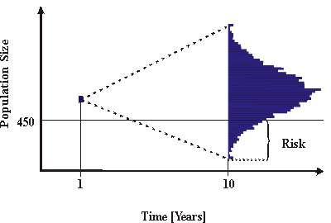
The importance of stochasticity (cont.)
This brings to mind that the mean growth rate of a population with variable r is given by the geometric mean: = 1.19. This would help if the assumption about the existence of the two states of r would be sufficient, and if the occurrence of good and bad years could be predicted without doubt.
Unfortunately, nature doesn’t work in this way. Considering that the probability that a year is bad is 0.5, there is still a ~ 0.1 % chance that 389 orchids only will occupy the meadow after 10 years. Moreover, we could also expect 2068 orchids by a 0.1% chance since we could have 10 consecutive good years.
Stochastic models provide the probabilistic framework to evaluate the consequences of such variability. The aim is to predict the probability distribution of the population size which is caused by the uncertainties of the environmental factors within a defined time horizon:

Slide 40
Template
template
End…
…Practical Handbook
(2. A first model)

Slide 41

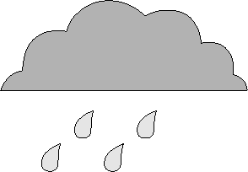
Types of uncertainty
Environmental variation signifies unpredictable differences in, e.g. precipitation, sun exposition, or wind velocity.

Slide 42
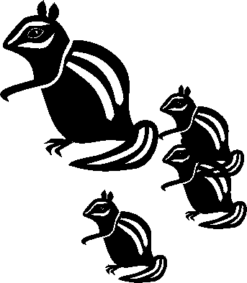
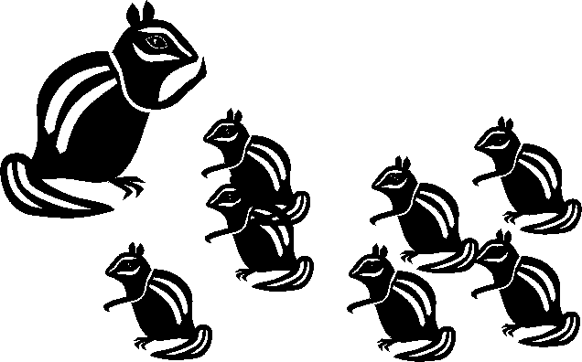
Types of uncertainty
Demographic variation means individual differences in the chance to survive and to have offspring.

Slide 43


Types of uncertainty
Phenotypic variation means the variation between the individuals of the same population. They might be caused by genetic and / or environmental differences.

Slide 44
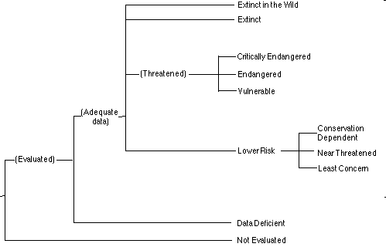
IUCN Conservation Status Categories
IUCN „Red List“

Slide 45
Probability of extinction
Vulnerable - 10% probability of extinction within 100 years.
Endangered - a 20% probability of extinction within 20 years or 10 generations, whichever is longer.
Critical – 50% probability of extinction within 5 years or two generations, whichever is longer.

Slide 46
Probability of extinction
Indeterminate - applies to taxa known to be endangered, vulnerable, or rare, but for which there is insufficient information to say which of the categories is most appropriate.
Presumed extinct - species are those which have not been located in the wild for the last 50 years.
Insufficiently known - species are those for which the information base is too small to define any risk category.

Slide 47
Additional terminology of risk assessment & conservation stats.
Added risk: is the increase of risk that results from some impact on a natural population. Anthropogenic responsibility is limited to added risk.
Background extinction rate: is the global average rate of extinction of taxa through time.
Competition with aliens, and invasive species is one of the recent causes of extinction.
Environmental variation like rainfall periods, pollution ect. can cause local extinction. Important is the time span of environmental changes. For example, long-lived species must survive short-term fluctuations in the environment and reproduce if the conditions are suitable.
Extinct species are those for which there is no doubt that the last member of this species is died.
Global extinction refers to the extinction of all members of a species in all of its constituent populations.
Habitat loss does not evoke an adaptive response of the individuals. Due to the lost resources (food, living space, nesting sites ect.), the risk of extinction increases dramatically.
Local extinction refers to the extinction of a single population in a spatially separated habitat.
Mass extinction refers to short periods of geological time in which many species in unrelated taxa become extinct.
Presumed extinct species are those which that have not been located in the wild for the last 50 years.
Probability of extinction specifies the chance that a certain population will extinct within a certain time horizon.
Quasiextinction risk is the chance of crossing a small population threshold being unacceptable for conservation, management, economic or aesthetic purposes.
Risk assessment is defined by Rowe (1977) as the process of obtaining quantitative and qualitative measures of risk levels.
Time to extinction is a variable which is often used in models to express the risk of extinction. The following histogram shows the time of extinction produced with 1000 simulations.

Slide 48
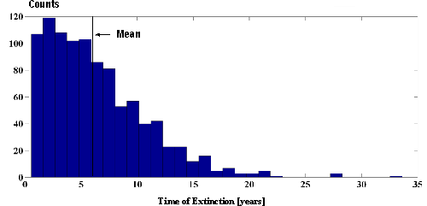
Time to extinction
The mean can be calculated but the shape of the distribution is more important. It shows that there is a high risk that the population go to extinct before the mean extinction time predicted.

Slide 49
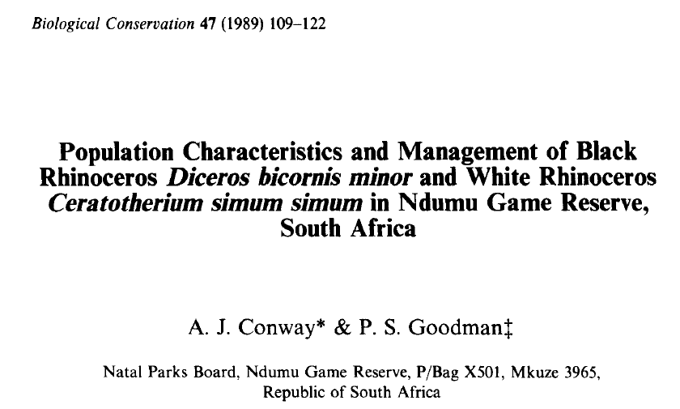
Intro to Case Study 1.

Slide 50
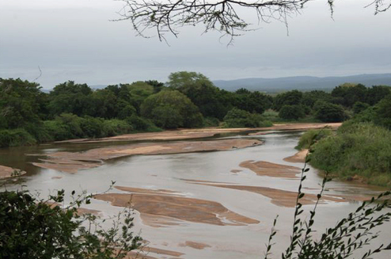
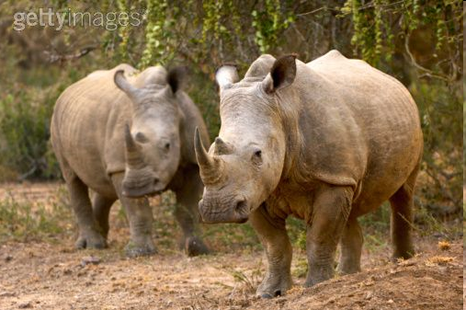
Population models for the White rhinoceros on Ndumu Reserve
This example bases on demographical studies about the white rhinoceros Ceratotherium simum simum at the Ndumu Reserve (Conway & Goodman, 1989). Ndumu is located at the Mozambique coastal plan. Its size is about 116 km². The population was established in 1961 - 1963 by introduction of 20 individuals.

Slide 51
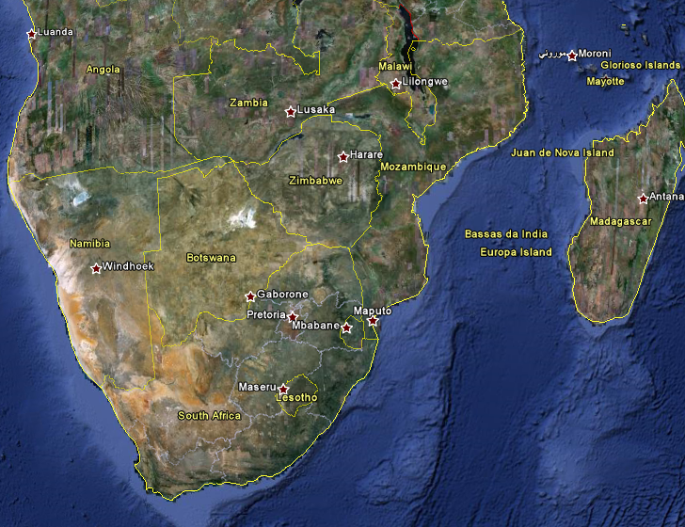
Ndumu Game Reserve
- South Africa

Slide 52
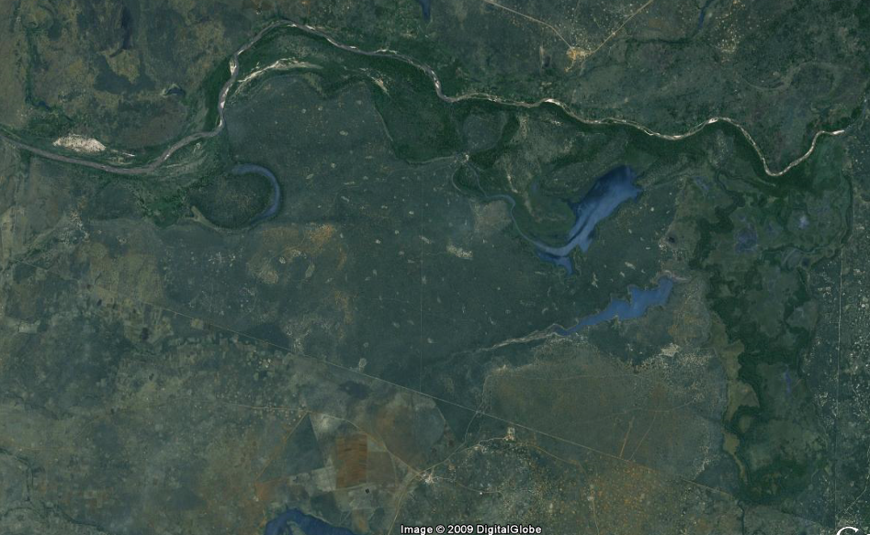
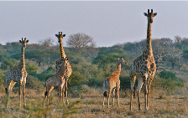
Ndumu Game Reserve
- South Africa

Slide 53
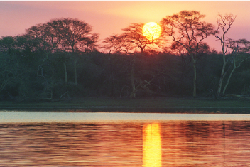
Population models for the White rhinoceros on Ndumu Reserve
Since rhinoceroses prefer dense woodland and thickets in the Ndumu Reserve, they are difficult to observe. Thus demographic data are scarce. The report of Conway & Goodman (1989) contains the following information:
57 individuals are in the population in 1986. This number can be subdivided into 18 males, 27 females, 4 yearlings, and 8 juveniles. In 1986, a total of 35 females were present.
the mean density is 0.49 km-2 which is a bit lower than in other reserves.
within the preferred habitat, the density can reach 2.68 km-2.
the estimated per capita birth rate is 0.14 per year.
the per capita death rate is 0.08 per year.
there is a 50% death rate in the transition from juvenile to yearling.

Slide 54
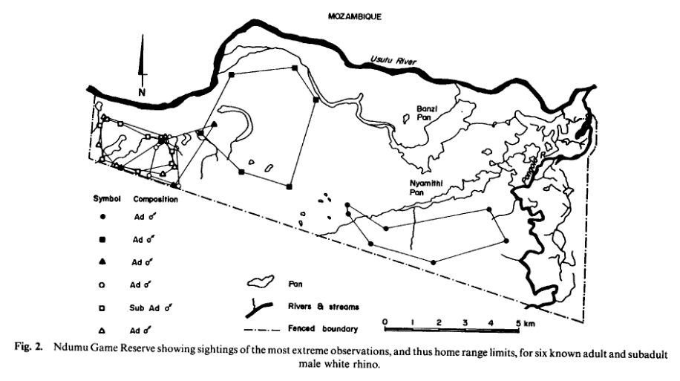
The population home ranges vary in size and location
The western zone of the park appears more favorable due to better forest coverage.
Given a positive growth rate, the population could increase to densities above optimal, thus periodic culling may be required.

Slide 55
Population models for the White rhinoceros on Ndumu Reserve
We will explore population control strategies.
Create a ceiling
Remove a constant number of individuals per year
Note: It will also be important to maintain the population (from the bottom-up) at levels that limit the probability of extinction

Slide 56
Exercises
Development of the population under natural conditions
Demographic stochasticity
Environmental variation
Multiple simulations – PVA & Quasi-extinction
Poaching
Management options(e.g. population ceiling, removing a constant number per year)

Slide 57
Template
To the computers…
…Practical Handbook
(3. Population Viability Analysis
3.1. Case Study: White Rhino)
template

Slide 58
Introduction into stochasticity
This procedure is time consuming. There is a faster implementation of this binomial distribution which can be used in an individual based model.
Solution: we use a so called uniform distribution:
0.14
0.0 1.0

Slide 59
Introduction into stochasticity
Assuming that there is a probability of b = 0.14 that a female gives birth to a female calf each year.
We then have a probability of ~b = 0.86 (0.86 = 1.00 – 0.14) that a female will not have an offspring.
This relation is described by a so called uniform distribution:
0.14
birth
0.0 1.0

Slide 60
Introduction into stochasticity
Assuming that there is a probability of b = 0.14 that a female gives birth to a female calf each year.
We then have a probability of ~b = 0.86 (0.86 = 1.00 – 0.14) that a female will not have an offspring.
This relation is described by a so called uniform distribution:
0.14
birth
no offspring
0.0 1.0

Slide 61
Introduction into stochasticity
The same principle counts for the probability that an individual will die (d = 0.08)
or survive (~d = 1.00 – 0.08 = 0.92):
0.08
die
survive
0.0 1.0

Slide 62
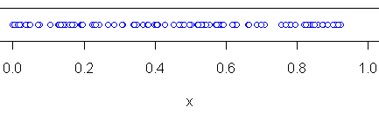
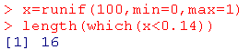
16 values between 0.00 - 0.14
84 values between 0.14 – 1.00

Slide 63
Template
End…
…Practical Handbook
(3. Population Viability Analysis
3.1. Case Study: White Rhino)
template

Slide 64
Age-class structured population models - introduction
For the prediction of population growth, it is sometimes necessary to track the individuals within certain age or size classes. This is useful, if demographic parameters as fecundity or survivorship change during individuals life and if this affects population’s structure.

Slide 65
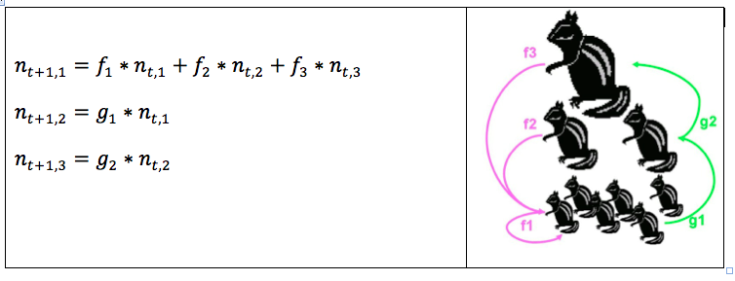
Age-class structured population models - introduction
Assume:
A population which can be structured into three different age classes x = 1,2,3.
Fecundity of the individuals could be labeled as f_{x}
The probability that the individuals survive their age class g_{x}.
N_{t,x}denotes the number of individuals within each age class at time t.
We can now calculate the number of individuals in the next time step as:

Slide 66
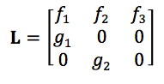
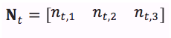
Age-class structured population models - introduction
This model makes two assumptions:
all age classes have the same size.
we have no survivors after the last age class.
The defined age classes must be, therefore, large enough to capture the entire life span of the individuals.
To condense the form of these equation we can use matrix arithmetic:
Includes all fecundities fx in the first row and the transition rates gx between the age classes in the "sub - diagonal". Since P.H.Leslie introduced this notation into the studies of population growth, it is called LESLIE - matrix.
Each element of this vector marks the individuals within an age class at time t.

Slide 67
Template
To the computers…
…Practical Handbook
(4. Matrix models)
template

Slide 68
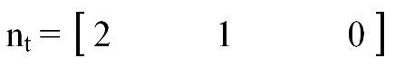
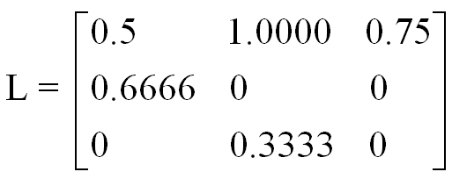
Matrix multiplication (1)
drop( )
n_{t+1}
%*%
1.0 + 1.0 + 0 =
2
=
1.3333 + 0 + 0 =
1.3333
0 + 0.3333 + 0 =
0.3333

Slide 69
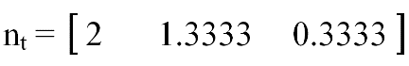
Matrix multiplication (2)
drop( )
n_{t+1}
%*%
1+1.3333+0.245 =
2.578
=
1.3333 + 0 + 0 =
1.3333
0 + 0.445 + 0 =
0.445

Slide 70
Age-class structured population models - introduction
With this formulation we can calculate the growth of the population according to:
n_{t+1} = L * n_{t}
If L remains constantly in time (i.e. the asymptotic growth rate). This value is also known as λ, and describes when the population structure has reached a stable distribution.
n_{t+1} = λ * n_{t}
λ is the dominant (the biggest) Eigenvalue of L.

Slide 71
Age-class structured population models - introduction
In last decades different matrix-types were stressed to analyze age- or size structured populations. Assuming that not all individuals of a certain size class leave the class after a defined time span but some of them remain within the class with a certain probability. Furthermore, the size classes could be better defined according to individual's performance (fecundity, survivorship, etc.) than to age. In this cases, the size of the classes to be defined could be you uneven. To handle this problem, USHER- matrix and/or LEFKOVICH - matrices are suitable:

Slide 72
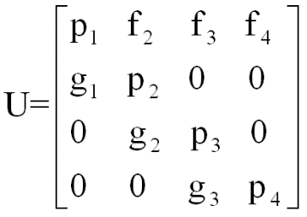
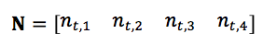
Stage-class structured population models - introduction
This is an USHER matrix where the diagonal elements p_{x} characterize the proportion of individuals in each stage who remain in that stage. The subdiagonal elements g_{x} are the proportion that graduate to the next stage per time step.
As an example the Loggerhead Sea turtle (Caretta caretta) problem will be discussed in this course.

Slide 73
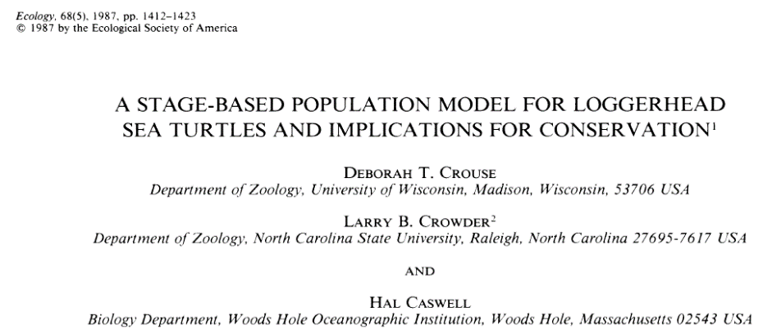
Intro to Case Study 2.

Slide 74
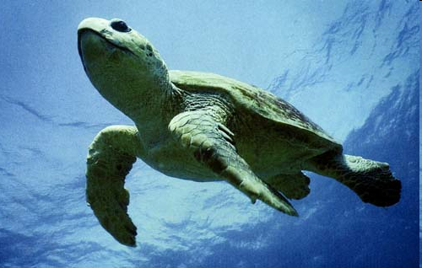
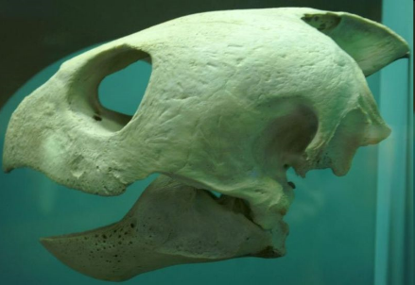
Loggerhead turtle Carretta carretta

Slide 75
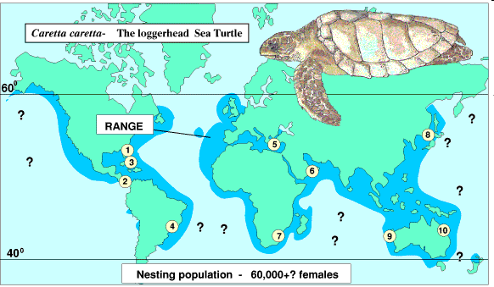
Loggerhead distribution
www.euroturtle.org

Slide 76
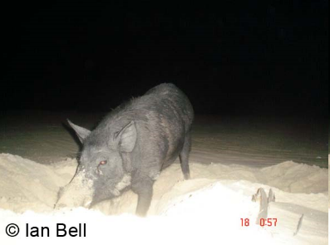
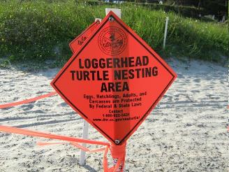
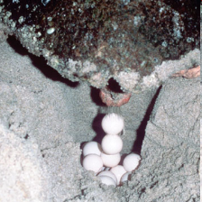


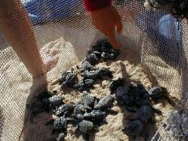
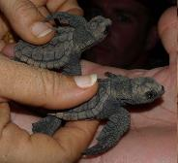
How to increase the population?
Protect nesting beaches

Slide 77
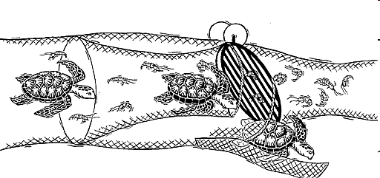
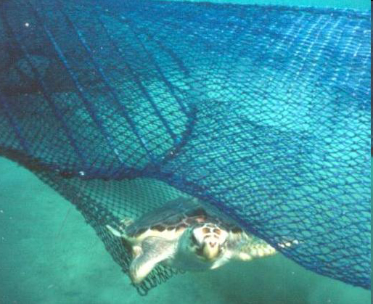
How to increase the population?
Turtle Excluder Device (TED)

Slide 78
Template
End…
…Practical Handbook
(4. Matrix models)
template

Slide 79
Management Strategy Evaluation
Similar to Population Viability Analysis but is not specifically addressing extinction risk.
The aim is to find management strategies that are robust to uncertainty rather than strategies that are optimal if a particular scenario is true

Slide 80
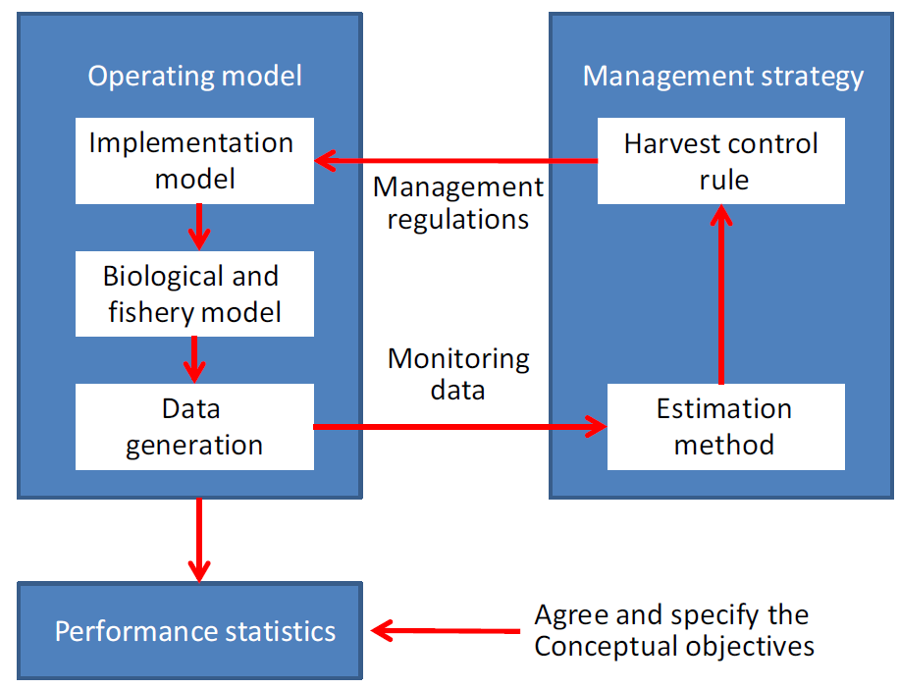
Conceptual overview of MSE
Conceptual overview of the management strategy evaluation modelling process (Fig. 1 of Punt et al. 2016)

Slide 81
Sources of uncertainty
Process uncertainty: variation in parameters often considered fixed in stock assessments such as natural mortality, recruitment and selectivity.
Parameter uncertainty: many operating models are fit to the data available, but the values estimated for the parameters of those operating models (e.g. fishery selectivity-at-age, the parameters of the stock–recruitment relationship and historical deviations in recruitment about the stock–recruitment relationship) are subject to error.
Model uncertainty: "All models are wrong“, Assumptions for stock recruitment relationship, missing covariates (e.g. climate change). Best to try several Oms.
Assessment uncertainty: Uncertainty arises when the model used for conducting assessments and providing management advice differs from the operating model, or the data are too noisy to estimate all key parameters reliably.
Implementation uncertainty: e.g. when catches are not the same as the TACs – typically more is taken or the decision-makers do not implement the TACs suggested by the management strategy.
Operating Model (OM)
Management Procedure (MP)

Slide 82
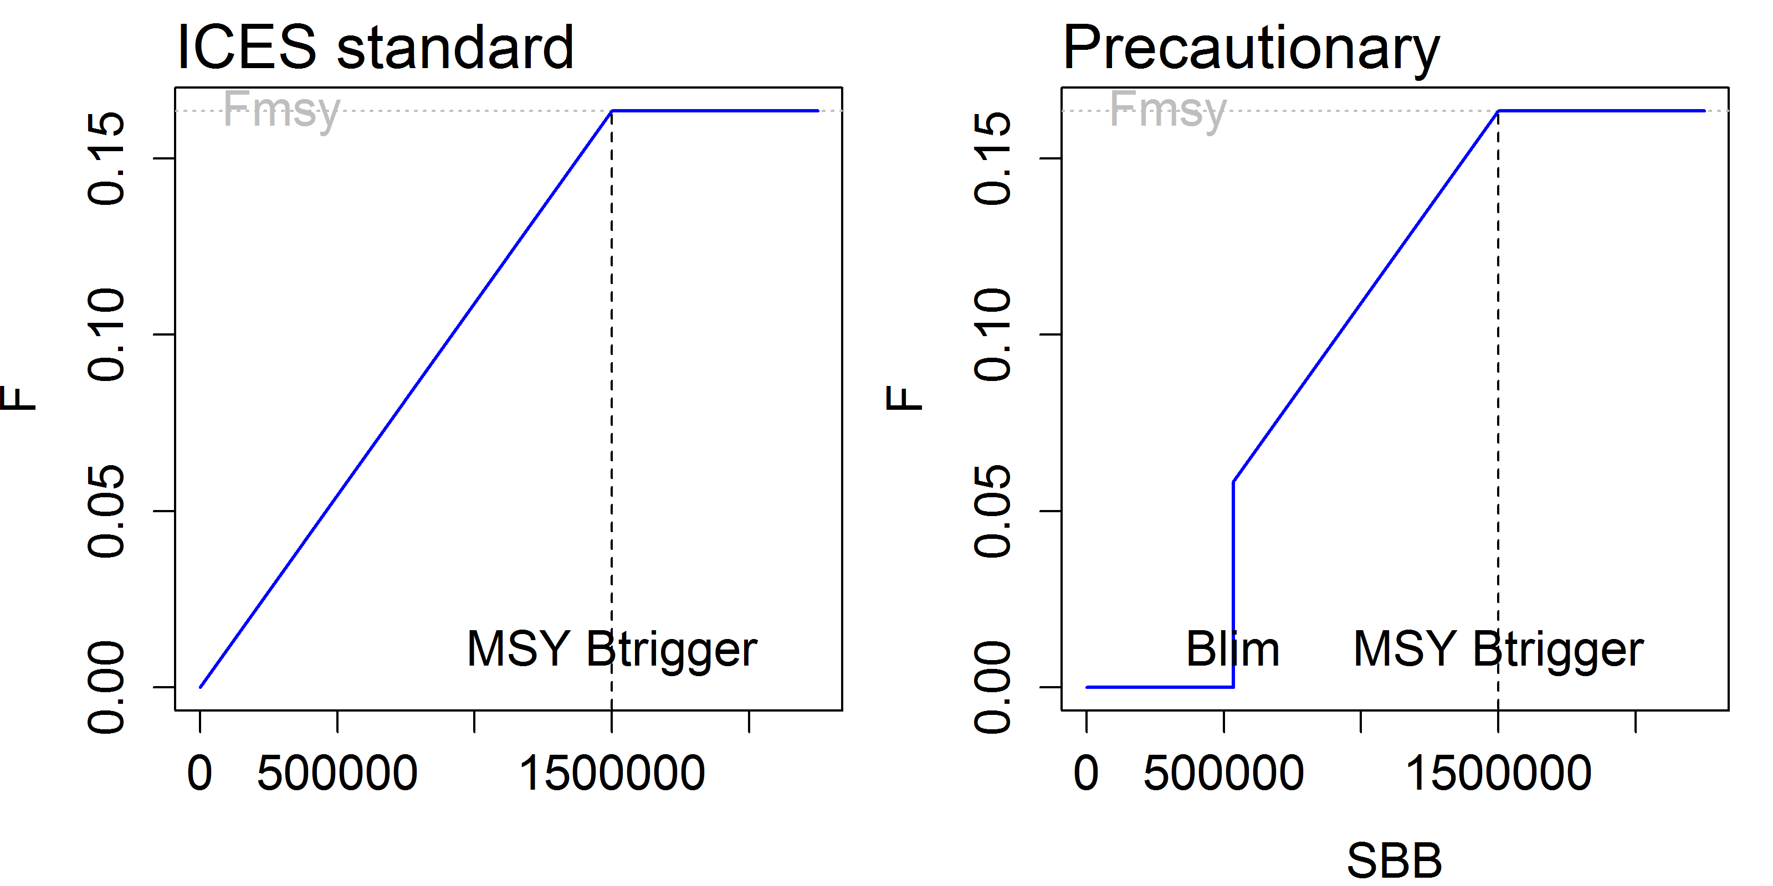
Harvest Control Rules

Slide 83
Template
Practical Handbook
(5. Management Strategy Evaluation)
template

Slide 84
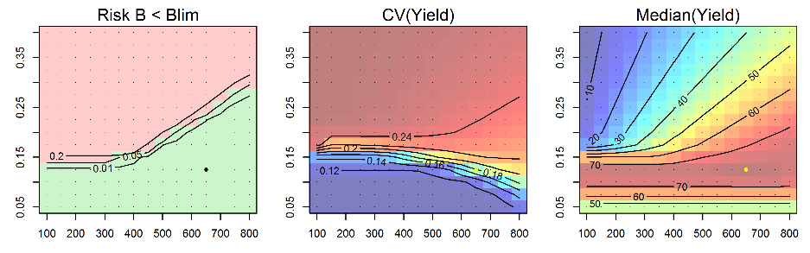
F_{target}
B_{trigger}

Slide 85
Template
template
Metapopulations
(Burgman et al., 1993)

Slide 86
Metapopulation theory
“population of populations that go extinct and recolonize” – Levins (1970)
A
B
D
C
E
Different spatial configurations:
A classical Levins-type metapopulation
B mainland–island configuration
C source–sink configuration
D spatially-structured population
E isolated populations.
Arrows indicate weak unidirectional exchange of individuals (←) , weak mutual exchange of individuals (↔) and strong mutual exchange of individuals (↔, in bold) (from Grimm et al., 2003)

Slide 87
Metapopulations and Spatial Structure
Spatial heterogeneity in the environment may result in a patchy distribution of organisms
Many species exist in a number of populations that are either isolated from one another or have limited exchange of individuals
Such a collection of interacting populations of the same species is called a metapopulation

Slide 88
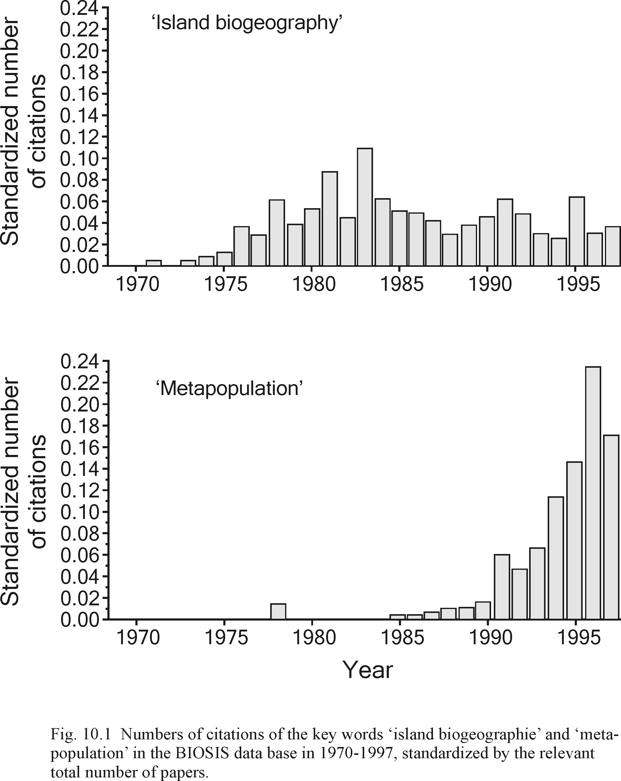
The metapopulation concept emphasizes the importance of connectivity between seemingly isolated populations.
Although no single population may be able to guarantee the long-term survival of a given species, the combined effect of many populations may be able to do this.
How is this concept different from the concept of “Island biogeography”?
(Hanski, 1999)

Slide 89

Island Biogeography

Slide 90
Island Biogeography
Spp richness related to:
Size of the island (available habitat): When large, the probability of extinctions due to chance events is decreased)
Immigration / emigration rates: When high, may increase re-colonization rate and lower the probability of extinction (distance from source population)
Isolated populations may follow different evolutionary routes (i.e. speciation)

Slide 91

Ex. Metapopulation Analysis
The simulated eggs and larvae dispersal pattern. Individuals colored according to the area where they were released.
(from Lett et al., 2008)

Slide 92



Ex. Metapopulation Analysis
Identification of source-sink populations
Temporal changes in the configuration due to changing current vectors through time
from Olivares, 2005; Mesodesma donacium in the IV Region of Chile

Slide 93
Metapopulation dynamics – an important concept in PVA
Conservation biology is concerned with the protection of species – not just single populations. Estimation of extinction risks must take into account the complex interactions between populations
Habitat fragmentation/loss is probably the major cause of species extinctions. This may create a metapopulation out of a previously single large population
Fragmentation can affect the movement and increase the isolation of populations. Modelling may attempt to identify of management strategies that reduce this isolation (e.g. rates of translocation, re-introductions)
Reserve design can benefit from information on metapopulation dynamics (e.g. single large reserve vs. several small reserves)

Slide 94


Slide 95


Fragmentation
Loss of habitat may result in discontinuities in the distribution of the remaining habitat.
Patches of habitat are decreased in size; distances increase between habitats; connectivity decreases; edge:size ratio increases (edge effect: may be less favorable habitat)

Slide 96
PVA in Metapopulation Models
As we have learned from PVA, when populations become small, e.g. as a result of habitat loss or fragmentation, environmental and demographic stochasticity can lead to frequent local extinctions and recolonizations
This may prevent individual populations from reaching equilibrium and staying there, although the metapopulation as a whole may persist longer than any individual population

Slide 97
Factors Affecting Extinction Rates
In a single population we have seen that population size and the degree of stochasticity affect extinction rates.
Metapopulations may persist as a whole over longer periods of time even if individual populations occasionally go extinct and are re-colonized.
Two key factors affecting the extinction risk of a metapopulation are:
1) Correlation - determines how frequently multiple population extinctions may coincide
2) Dispersal rate - higher rates result in faster re-colonization, reducing extinction risk

Slide 98
Correlation of environmental variation among populations
Spatial correlation, or autocorrelation, measures of the amount of association between measurements of a variable made at points at a given distance apart. We could measure a single variable (say, rainfall) at intervals of 1 km across the landscape.
If two populations are close to each other geographically, they will often experience similar environmental patterns - for example, the same sequence of years with good and bad weather. This will result in a positive correlation between the vital rates of the two populations inducing a correlation between the population trajectories.
e.g. Good rains in one habitat patch will mean there probably will be good rains in the other habitat patch.

Slide 99
single population extinctions – e.g. low environmental correlation
multiple population extinctions – e.g. high environmental correlation

Slide 100



EXAMPLE: Boer, 1981
Variation in the sizes of populations of P. versicolor may be less strongly correlated with one another through time because the species is less sensitive to correlated environmental conditions, or because it has better dispersal capabilities.
Higher correlation = higher risk of extinction

Slide 101


Correlation of environmental variation among populations
In the extreme case where the populations are very close, this correlation may be perfect and they may become extinct at the same time.
where:
P = probability that all populations go extinct
E = probability that any single population goes extinct
At the other extreme, when the environmental variations that the populations experience are completely dissimilar, the total extinction probability will be a product of the probabilities as described above. For an n-population system:

Slide 102


Correlation of environmental variation among populations
The difference between the two equations can be very important from the point of view of species conservation.
e.g. Consider a metapopulation of 5 local populations. Suppose that each population has an extinction probability of 1% within the next 10 years. For this metapopulation, the first equation will give a total extinction risk of:
whereas the second equation will give a risk of:

Slide 103
Correlation of environmental variation among populations
In most cases, the similarity of environmental factors (hence the correlation among extinction events) will be somewhere between these two extremes.
If the models used to study metapopulations do not incorporate correlations, one needs to assume either of these two extremes. The assumption of perfect correlation (1st equation) will overestimate the extinction risk, whereas the assumption of independent environments (2nd equation) will underestimate it.

Slide 104


Dispersal Patterns
Kitching (1971) showed that a simulation model of dispersion can reproduce the logarithmic curve for disperal patterns observed in nature:
where:
m is the rate of dispersal (expressed as the proportion of the current source population leaving per unit time),
d is the distance between the source and target patches, and
c is a constant representing the average distance a migrant travels per unit time.

Slide 105
Other factors affecting dispersal
Other factors besides distance may also affect the topology of migratory connections in a metapopulation.
Even if two patches are geographically close, the unsuitable habitat or geographic barriers that separate them may make the dispersal rates small. On the other hand, habitat 'corridors' may facilitate dispersal and therefore connect distant patches.
What other factors may influence dispersal rates?
Currents, water flow
Population density
Age, sex and genetic structure of the populations

Slide 106
Template
To the computers…
…Practical Handbook
(5. Metapopulation model)
template

Slide 107

Dispersal Patterns
3-pop

Slide 108

All together now…
Affect of environmental correlation + dispersal on extinction rate:

Slide 109
Continuous populations
Continuous populations with approximately instantaneous immigration among its sub-populations
Metapopulations whose populations receive some immigrants, including island - mainland systems
Isolated populations too far apart for effective immigration.
Metapopulations
Dispersal distance →
Isolated populations
Distance between patches →

Slide 110
Template
template
ABMs + Netlogo examples

Slide 111


Slide 112


Slide 113
Agent- or Individual-based modelling
Simulates the actions and interactions of autonomous individuals in order to assess their effects on the system as a whole.
Applications:
Individual characteristics important (e.g. size affects egg-production; size-limited predation)
Individual behavior important (e.g. density-dependent reproduction; movement, competition, recruitment)
Spatial-temporal dynamics important (e.g. competition, schooling)

Slide 114


ABMs can give further insight into unknown processes.
An “emergent property” of the system may result from a lower level process
ABMs can allow for the testing of hypotheses
What lower level processes are responsible for the observed pattern of the system (“Pattern Oriented Modelling” – POM) ?

Slide 115



Pattern Oriented Modelling
Model selection
MODEL A
Hypothesis of
Process A
?
MODEL B
Hypothesis of
Process B
Pattern of unknown process

Slide 116


Pattern Oriented Modelling
The parameter of width of tube:
W = 15
http://www.boatus.com/cruising/ithaka/200504-15.asp
Pattern of brain coral colonies
Model of tube creation algorithm Truchet

